Slide 1


Department of Computer Science and Engineering
SMART FITNESS PLANNER
Mrs Divya M , M.E
Assistant Professor
Nishal I P
220701187

Slide 2
Problem Statement and Motivation
People often struggle with generic workout plans that don’t suit their fitness level/goals.
Existing apps don’t personalize plans using past exercise data.
Manual planning wastes time and is error-prone.
High dropout rates in unpersonalized fitness programs
Motivation: Use ML to provide smarter, customized weekly workout plans.

Slide 3
Existing System
Static workout schedules
One-size-fits-all fitness apps
No learning from user feedback or history
No predictive recommendations
Fails to adjust for fitness level, time, or equipment
Limited variety in suggested exercises.

Slide 4
Objectives
Generate synthetic user + workout datasets
Design realistic fitness datasets (users, workouts, ratings)
Build a ML model to predict user exercise preferences
Recommend top-rated exercises per user profile
Predict ratings for user-exercise pairs
Create a 7-day workout plan targeting fitness goals

Slide 5
Abstract
The global shift toward healthier lifestyles and the rise of digital fitness tracking have created an urgent need for personalized workout solutions that are both scalable and data-driven. Traditional workout plans are often generic and fail to consider the unique physiological and motivational differences between individuals. As a result, fitness adherence drops, and users are less likely to achieve their health goals. This research addresses the challenge by developing a machine learning–based personalized workout planner that predicts optimal exercise routines for users based on their personal attributes and historical fitness behavior.

Slide 6
Proposed System
Data Pipeline: Auto-generation of synthetic users & workouts
ML Model: Trained neural network with low mean squared error
Recommendation Engine: Personalized exercise ratings
Weekly Plan Generator: Balances time, goal, fitness level
Output Module: JSON for external use

Slide 7
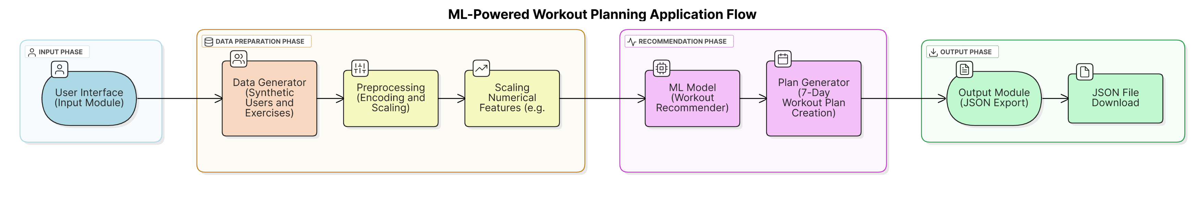
System Architecture

Slide 8
List of Modules
User Data Generator: Age, weight, goals
Exercise Data Generator: Type, muscles, calories
Workout History + Ratings
Label Encoders & Scaler
Workout Planner Logic

Slide 9
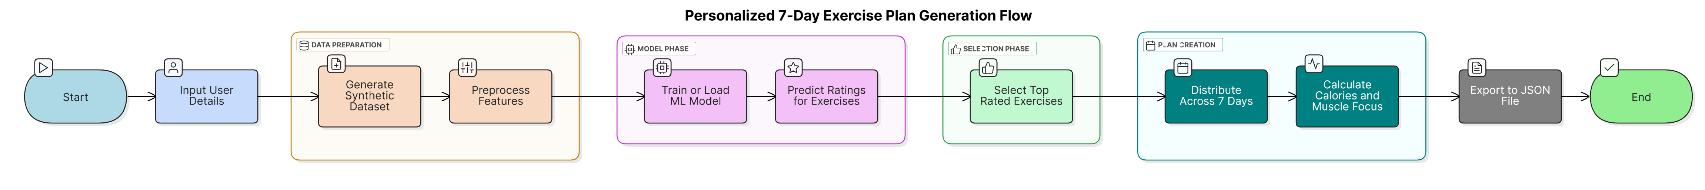
DATA FLOW DIAGRAM

Slide 10
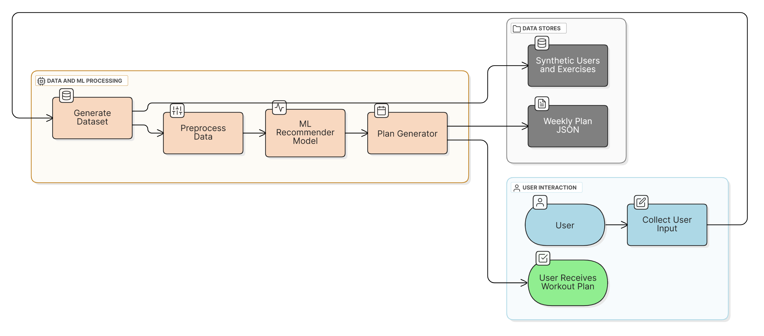
Activity Diagram

Slide 11
Implementation & Results of Module
Keras NN trained for 10 epochs with MSE loss
Scaled data using StandardScaler.
Training MSE: ~0.78
Test MSE: ~0.85
Achieved Meaningful rating predictions
Weekly plan include sets,reps and calories burned
JSON ready for mobile/web app usage

Slide 12
Conclusion & Future Work
ML successfully used to personalize fitness planning
Generates diverse, realistic exercise suggestions
Can help improve consistency in workouts
Future: Add wearable integration (steps, heart rate, calories) for real-time feedback.
Chatbot interface for asking questions, plan reminders, or modifications.
Include injury recovery or rehab modes.
Real time user ratings to retrain model.

Slide 13
References
Scikit-learn & TensorFlow Documentation
ACSM Guidelines for Exercise MET Values
Numpy, Pandas for data generation
Research papers on ML-based recommender systems

Slide 14
Paper Publication Status
Project at implementation-complete stage
Potential for publishing on IEEE or Springer
Waiting for full approval from our mentor.

Slide 15
Thank You

